Slide 1
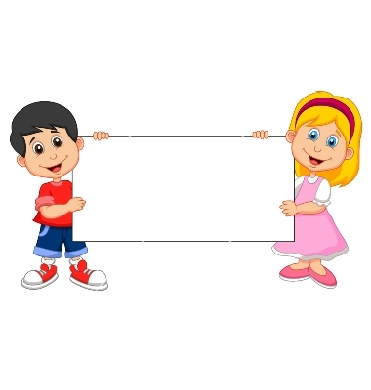
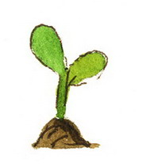
Donation
(Unable Plant)

Slide 2
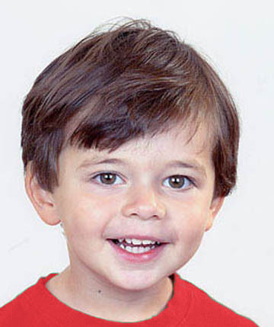
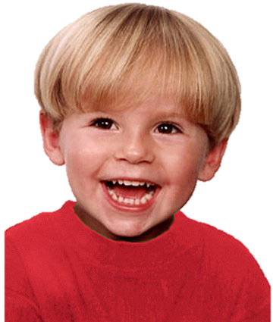
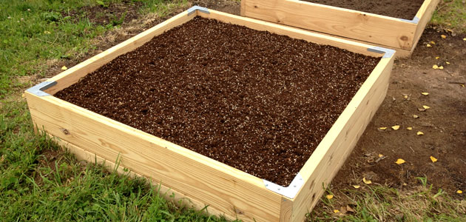
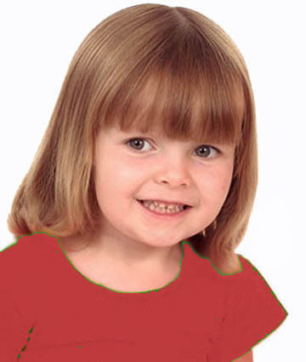
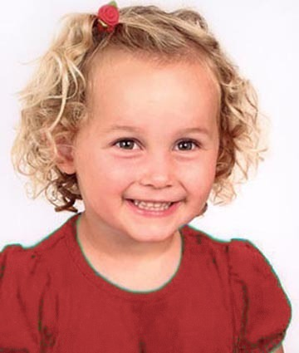
Introduce the group & the garden

Slide 3
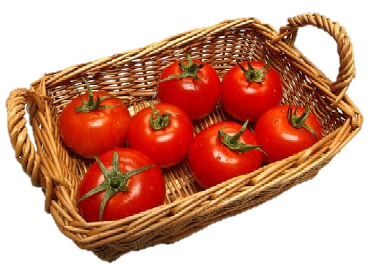
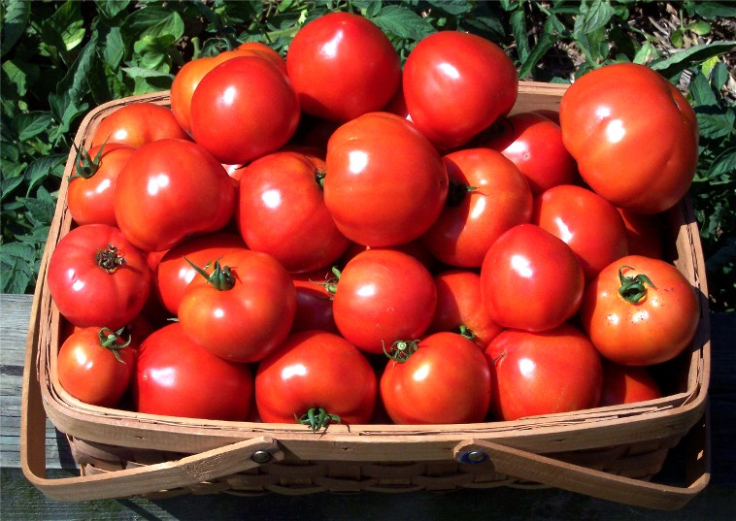
Explain how the garden works

Slide 4
Questions & Feedback

Slide 5
Test Task

Slide 6
The group goal: have a big basket of tomatoes and share them

Slide 7
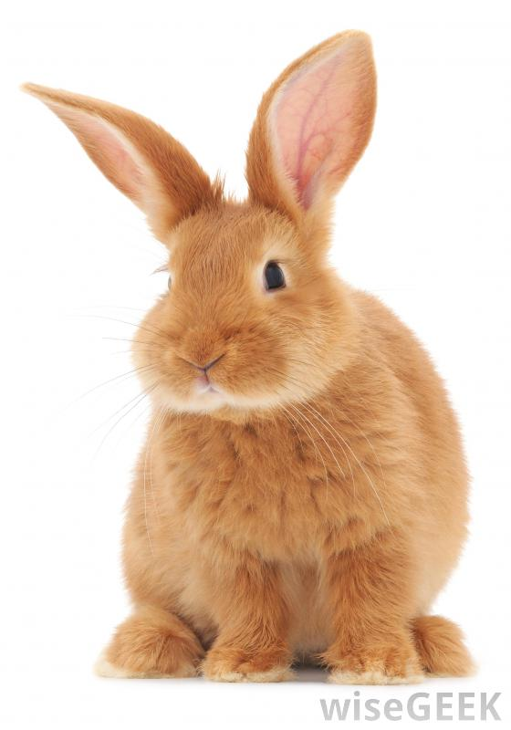
The boy (on the upper right corner) wants to put his plant in the group garden, but a rabbit comes to eat his plant. The other children put their plants into the garden.
Notes:
The boy (on the upper right corner) wants to put his plant in the group garden,
but a rabbit comes to eat his plant

Slide 8
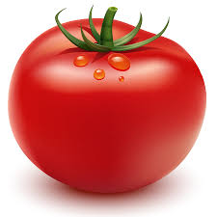

The outcome: They get a small basket of tomatoes. Each kid gets a tomato.

Slide 9
Test Questions
F
C

Slide 10
Unable Free-Rider Reminder:
Wanted to put his plant in the garden but a rabbit ate it.

Slide 11

Evaluation: is he good or bad?

Slide 12
Evaluation: a little good/bad or really good/bad?

Slide 13


Preference: Do you like him or you don’t like him?

Slide 14


Preference: do you like him a little or a lot? do you kind of don’t like him or really don’t like him?
To Contributor

Slide 15
Test Questions
Contributor

Slide 16
Contributor Reminder:
Wanted to put his plant in the garden and put it there.

Slide 17
Evaluation: is he good or bad?

Slide 18
Evaluation: a little good/bad or really good/bad?

Slide 19
Preference: Do you like him or you don’t like him?

Slide 20
Preference: do you like him a little or a lot? do you kind of don’t like him or really don’t like him?
To Free-Rider

Slide 21

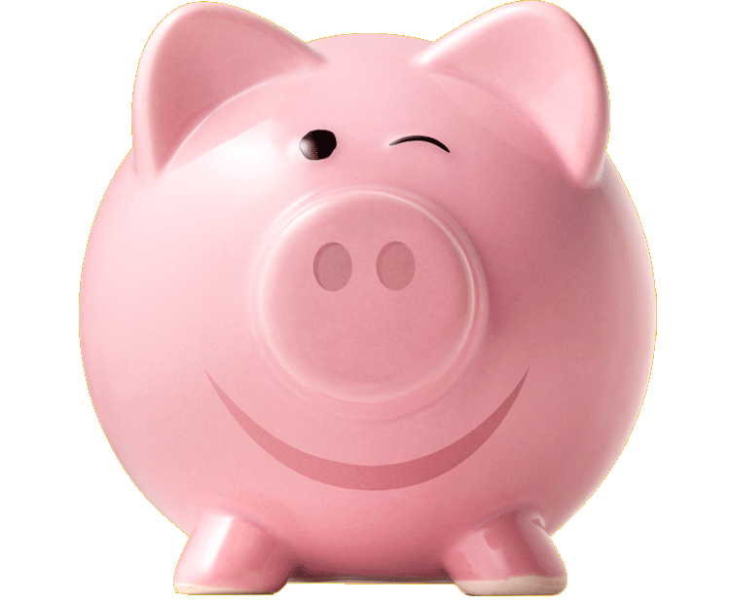
Donation
(Unwilling Piggybank)

Slide 22
Boys Version
Familiarization Task

Slide 23
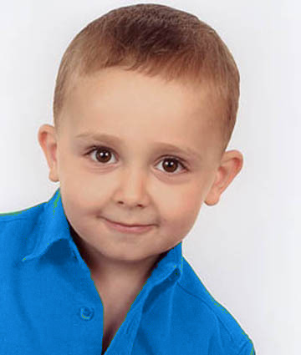
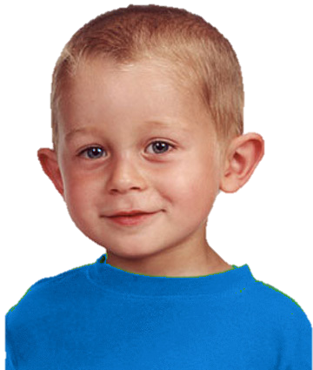
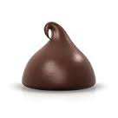
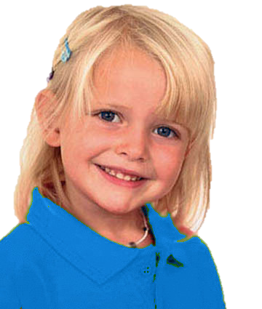

Introduce the group & the piggybank

Slide 24
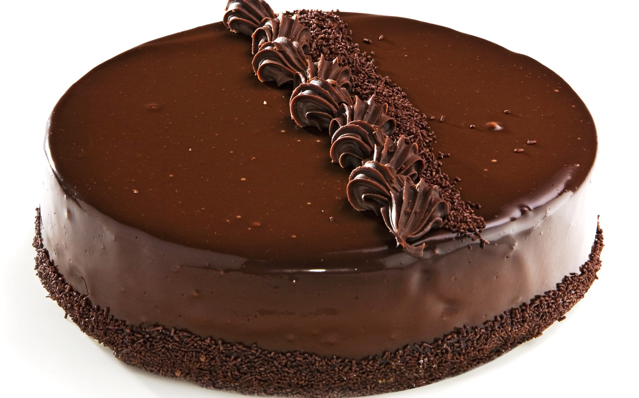
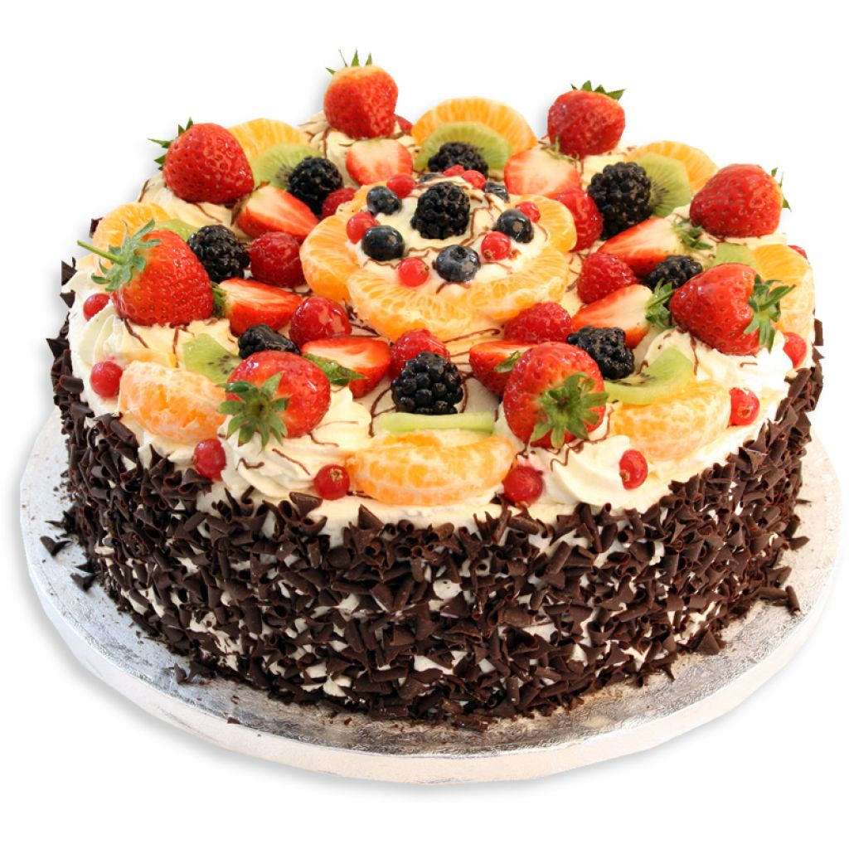
Explain how the piggybank works

Slide 25
Questions & feedback

Slide 26
Test Task

Slide 27
The group goal: have a big cake and share it

Slide 28
Unwilling free-rider (upper left):
Doesn’t want to put his chocolate into the piggybank; he eats it

Slide 29
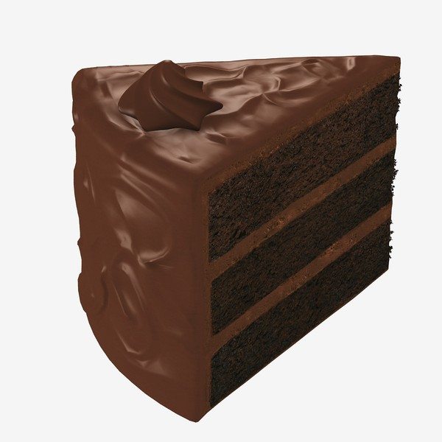
The outcome
The outcome: The piggy bank makes a small cake. Each kid gets a piece of it.

Slide 30
Test Questions
F
C

Slide 31
Unwilling Free-Rider Reminder:
Didn’t want to put his chocolate into the piggybank and ate it.

Slide 32
Evaluation: is he good or bad?

Slide 33
Evaluation: a little good/bad or really good/bad?

Slide 34
Preference: Do you like him or you don’t like him?

Slide 35
Preference: do you like him a little or a lot? do you kind of don’t like him or really don’t like him?
To Contributor

Slide 36
Contributor Reminder:
Wanted to put his chocolate into the piggybank and put it there.

Slide 37
Evaluation: is he good or bad?

Slide 38
Evaluation: a little good/bad or really good/bad?

Slide 39
Preference: Do you like him or you don’t like him?

Slide 40
Preference: do you like him a little or a lot? do you kind of don’t like him or really don’t like him?
To Free-Rider

